Slide 1
SEMIKONDUKTOR DAYA
Safrizal, ST., MT.

Slide 2
Kompetensi
KOMPETENSI DASAR
Menguasai karakteristik semikonduktor daya yang dioperasikan sebagai pensakelaran, pengubah, dan pengatur.
Menguasai dasar prinsip kerja rangkaian elektronika daya, antara lain: penyearah, konverter, AC regulator, chopper, dan inverter.
STANDAR KOMPETENSI
Mampu menerapkan prinsip dasar pensakelar elektronis dari komponen semikonduktor daya dalam rangkaian elektronika daya.

Slide 3
Rangkaian elektronika daya
Suatu rangkaian listrik yang dapat mengubah sumber daya listrik dari bentuk gelombang tertentu (seperti bentuk gelombang sinusoida) menjadi sumber daya listrik dengan bentuk gelombang lain (seperti gelombang nonsinusoida) dengan menggunakan piranti semikonduktor daya

Slide 4
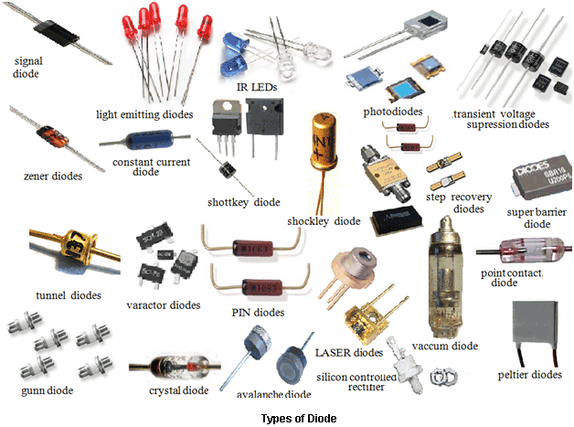
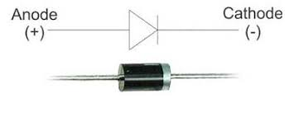
DIODA

Slide 5
Cara kerja dioda

Slide 6
Testing The Prototype
  What worked? What did not work? Why?
  What materials need to be changed and/or kept? Why?
  Did the size of your prototype give you enough information to move forward with a final product? Why or why not?
  Did you have other people test your design and give you feedback? Why or why not?

Slide 7
Redesigning The Prototype
  Use the data from your testing to redesign with…
    Different materials
    Different builds
    Different sizes
  Write about or show images of your prototype redesigning process and result

Slide 8
Final Result
Once you have a final product, go back to your second slide and review the initial questions you answered
  Does your final prototype solve your problem for the person or people for whom it needs to be solved?
    If yes, WAY TO GO! But always think about if you can improve it even more!
    If no, copy this PowerPoint and start the problem/solution cycle again
Insert pictures of your final design
Discuss why this design solves the problem
Reflect on how you feel about the process from start to finish in this project

